Slide 1


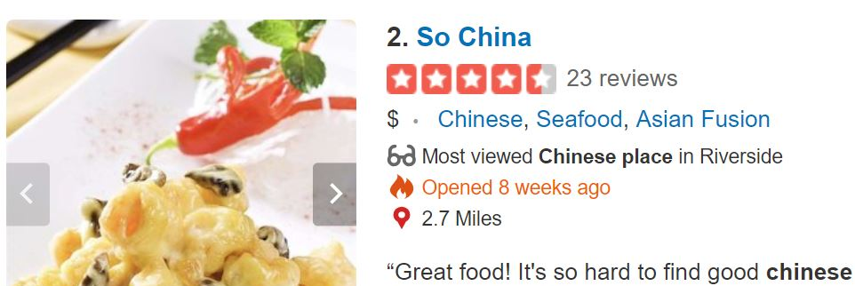
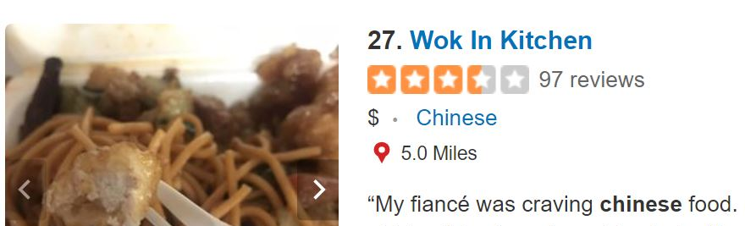
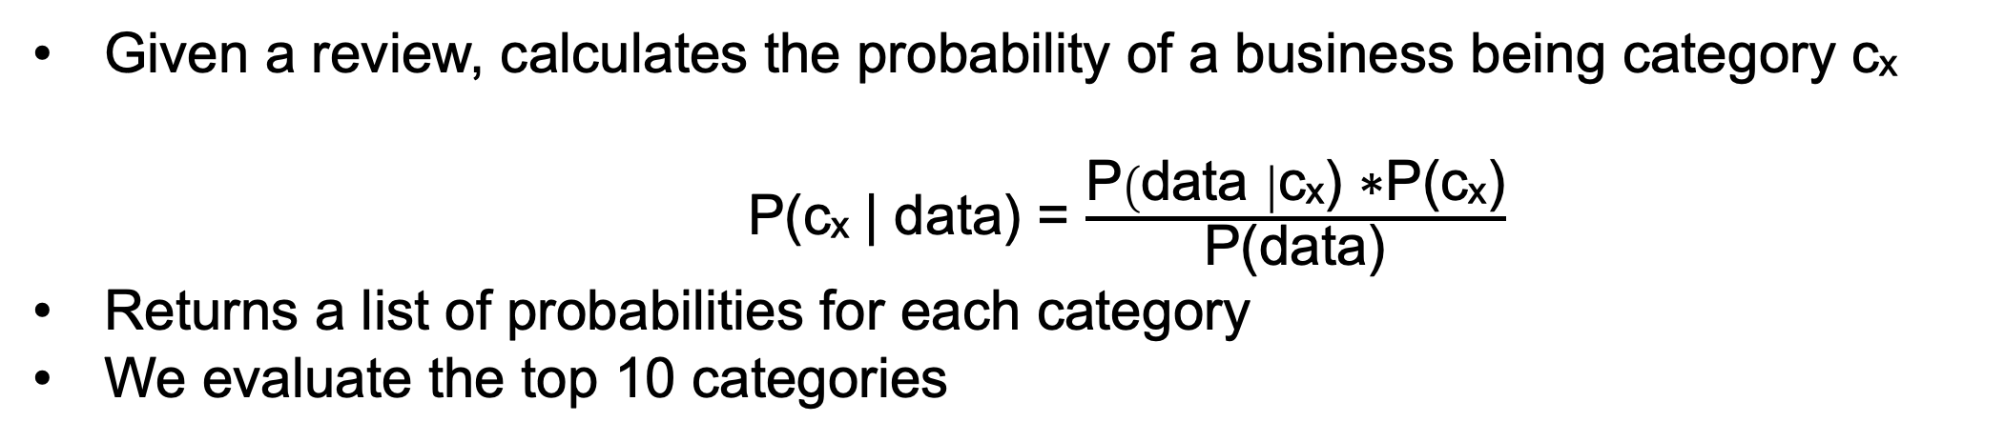

Yelp Automatic Category Labeling
Andrea Cruz Castillo, Computer Science
Faculty Advisor: Mariam Salloum, Computer Science and Engineering
University of California, Riverside
Co-authors: Harini Venkatesan, Moses Park
Introduction
Feature Extraction
Approaches Cont.
You would like to go out for pasta, so you search for “Italian Restaurant” on Yelp. Category labels are critical business information that Yelp uses to filter user-search results and assist sales team to target a specific group of businesses [2]. However, many businesses fail to list categories, or list a limited set of relevant categories. Lack of such data can have a great impact on a business’ popularity as it will affect its rank in the search result and hence be less likely to be clicked on compared to other businesses. With the advent of social-media, a business’s success is tied to its online presence and incomplete or missing data can make or break a business. Business listings are rich in metadata that can inform the businesses' categories, such as reviews, menus, amenities, etc. In this ongoing work, we examine various approaches to enrich a business listing by automatically classifying categories based on user-reviews.
Frequent Itemset
Data
(user-reviews)
Clean Data
(lowercase text, then remove stop words and punctuation)
Categories List
Generate Item sets of size 5 or less
Check Support:
Probability of itemset occurrence > 80%
Feature Constructor
[‘accessories’, ‘clothing’]
[‘accessories’, ‘clothing’, ‘fashion’]
[‘accessories’, ‘clothing’, ‘salon’]
{‘accessories’}
{‘clothing’}
{‘fashion’}
{‘salon’}
{‘accessories’, ‘clothing’}
{‘accessories’, ‘fashion’}
{‘accessories’, ‘salon’}
{‘accessories’, ‘clothing’, ‘fashion’}
{‘accessories’, ‘clothing’, ‘salon’}
Output Frequent Items of size 5 or less
Objective
Create Index
(Vocabulary)
Create Features
{‘accessories’}
{‘clothing’}
{‘fashion’}
{‘accessories’, ‘clothing’}
{‘accessories’, ‘fashion’}
{‘accessories’, ‘clothing’, ‘fashion’}
Utilize data from classified businesses to predict labels for unclassified businesses. Thus, increase popularity of unclassified businesses in search results.
Figure 5. Describes overall process to extract features.
Figure 8. Describes process to extract frequent item sets from list of sets.
Frequent Item sets helps us discover patterns in the hierarchy of categories.
Given a list of category sets, it returns a list of the most frequent item sets.
Frequent sets are used on top of Naïve Bayes predictions to obtain labels that Naïve Bayes might have missed.
'crave real burgers go with truffle fries love all of their burgers and their margaritas are the best'
'crave real burgers truffle fries love their burgers their margaritas best'
Analysis
Figure 1. Sample Business with multiple labels and high search result ranking.
{'best': 0, 'burgers': 1, 'crave': 2, 'fries': 3, 'love': 4, 'margaritas': 5, 'real': 6, 'their': 7, 'truffle': 8}
Figure 2. Sample business with few labels and low search result ranking.
Method 1 CountVectorizer
[1 2 1 1 1 1 1 2 1]
Method 2 TfidfVectorizer
[0.26, 0.52, 0.26, 0.26, 0.26, 0.26, 0.26, 0.52, 0.26]
Challenge
Figure 9. Compares recall results from both feature extraction methods using different input.
Level 1
Automotive
Restaurants
Figure 6. Sample feature creation of a review. Shows the vector representation of both methods
Method 1: CountVectorizer checks if a word is present in the given input, say a review, the value for that word is equal to the number of times the word appears in the review. Else, the value is 0.
Method 2: TfidfVectorizer assigns the word’s TFIDF value. TF stands for Term Frequency and IDF stands for Inverse Document Frequency. Therefore, the TFIDF score for term t in document d = TF(t,d)*IDF(t) , where
TF(t,d) = $\frac{\text{Frequency} \text{of} \text{term} \text{t} \text{in} \text{document} \text{d}}{\text{Total} \text{number} \text{of} \text{words} \text{in} \text{document} \text{d}}$
IDF(t) =$\text{log}{\frac{\text{Total} \text{number} \text{of} \text{documents}}{\text{Number} \text{of} \text{documents} \text{with} \text{term} \text{t}}}$
In both cases we tokenize a review by ‘words’ and then compute each token’s weight using either Method 1 or 2. We plan to also explore other feature extraction methods like n-grams.
Level 2
Gas Station
Tires
Car Wash
Chinese
Latin American
Mexican
Level 3
Dim Sum
Hainan
Cantonese
Colombian
Salvadoran
Figure 10. Compares precision results from both feature extraction methods using different input
Figure 3. Example hierarchy structure of Yelp’s categories.
As shown in Figures 9 and 10, the best recall and precision is obtained when using CountVectorizer to create our features and Naïve Bayes as our model. We also obtain better results by removing stop words and by combining the business name and the review. Initial experiments shows that combining frequent itemset with Naïve Bayes does not significantly improve our recall or precision.
Dataset Exploration
We utilized the Yelp Challenge Dataset which includes a subset of businesses and fields such as business name, location, associated categories, amenities, images, as well as full-text reviews [1]. Below we provide a brief summary of the available dataset. We shall assume that this is a golden dataset and utilize the data to train and test our predicting models.
Approaches
Further Work
Naive Bayes
Remove noise from dataset since data is not entirely noise free.
Test the effect of using n-grams (bigrams, trigrams) for our features creation.
Integrate other metadata to train our models such as menus or images [4].
Try other models such as Random Forest and/or Neural Networks.
Data Statistics
Number of Categories | 1,322
Number of businesses | 188,593
Number of Reviews | 571,970
Avg. number of reviews per business | 324 reviews
Avg. length of reviews | 57 words
Data
Features / Labels
Test Set
Evaluate
Train Set
Trained Model
Probabilities
(Predictions)
References
[1] "Yelp Dataset Challenge," Yelp, [Online]. Available:
https://www.yelp.com/dataset_challenge. [Accessed January 2019].
[2] N. Tung, “Automatically Categorizing Yelp Businesses,” September 2015. [online]. Available: https://engineeringblog.yelp.com/2015/09/automatically-categorizing-yelp-businesses.html [Accessed January 2019]
[3] J. Fennell, K. Shiells, and B. Sitaraman, “Auto-Categorization of Businesses on Yelp.com,” June 2009. [online]. Available: https://nlp.stanford.edu/courses/cs224n/2009/fp/15.pdf. [Accessed February 2019].
[4] E. D. Rosenfeld and M. Iannelli, “Automatic Business Attribute Labeling from Yelp Reviews.” [online]. Available: https://pdfs.semanticscholar.org/3326/31c5bb936e7bbc8ae632d26ba70a3c780ee8.pdf. [Accessed April 2019]
Figure 7. Naïve Bayes model construction overview.
Given a review, calculates the probability of a business being category cₓ
P(cₓ | data) = $\frac{\text{P}\left(\text{data} \right|\text{c}\text{ₓ) ∗}\text{P}\text{(}\text{c}\text{ₓ)}}{\text{P}\text{(}\text{data}\text{)}}$
Returns a list of probabilities for each category
We evaluate the top 10 categories
Table 1. Summary of dataset statistics.
Figure 4. Number of categories at each level of the hierarchy.

